Slide 1
Image Colorization
Sarvesh Shroff | Akshay Jain
A20488681 | A20502846

Slide 2
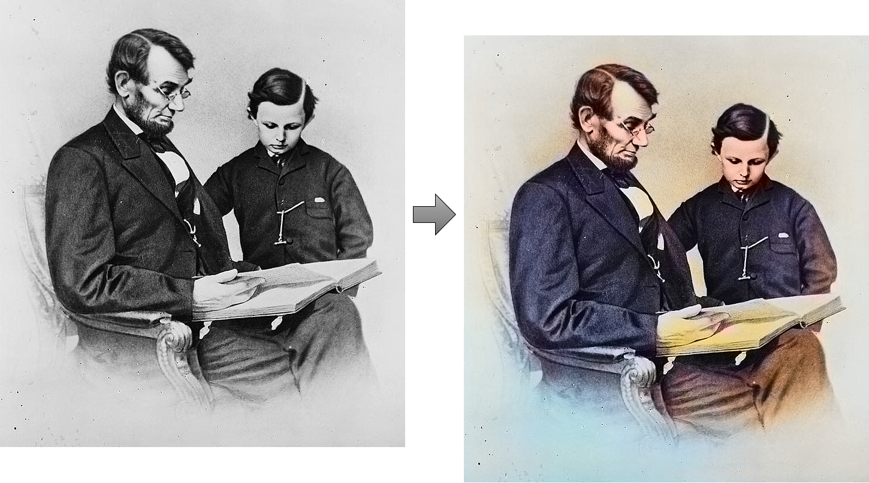
Image Colorization
It is the process of estimating RGB colors for grayscale images or video frames to improve their aesthetic and perceptual quality.
Applications:
The image colorization systems find their applications in astronomical photography, CCTV footage, electron microscopy, etc.
Notes:
Challenges for colorization of image
Grasyscale –> RGB (single channel to 3 chanel)

Slide 3
Challenges in Image Colorization
1. Two of the three dimensions are missing for the input image.
2. Highly Uncommon Semantics for many man-made and natural objects.
3. Image Enhancements.

Slide 4
Different Algorithms/Approaches can be used to colorize images
Using Supervised Machine Learning Algorithms
Using AutoEncoder (used by us)
Using GANs (Generative Adversarial Networks) which is an example of semi-supervised learning
and many more.

Slide 5
AutoEncoder Approach (for Image Colorization)
AutoEncoders are built from two components:
Encoder
Transforms the input data into a lower-dimensional representation just like PCA.
To achieve this goal, the encoder must learn only the “most important features” of the data.
Decoder
Recovers the input image size from the low-dimensional representation using Upsampling.

Slide 6
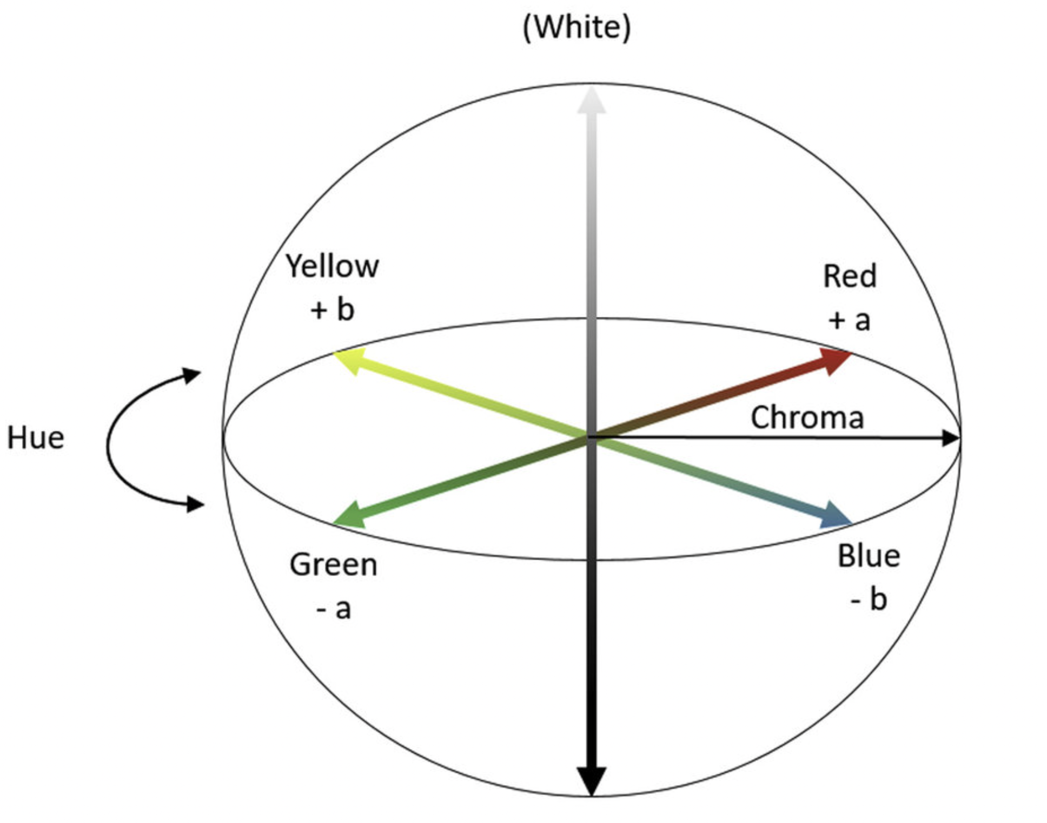
LAB as Input
Figure: “CIELAB, or CIE L* a* b, color system diagram” (represents quantitative relationship of colors on three axes: L value indicates lightness, and a* and b* are chromaticity coordinates)

Slide 7
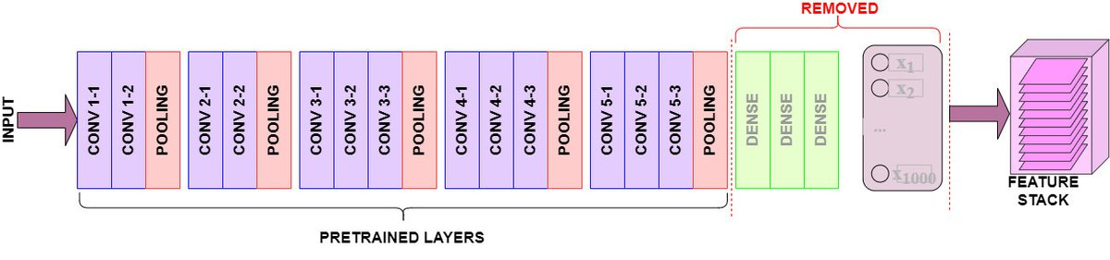
VGG16 as Encoder (Transfer Learning)
Figure: shows the "top" portion of the model as removed. The model convolves the pre-trained output layers left behind as a 3D stack of feature maps.

Slide 8
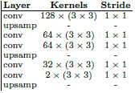
Decoder
Conv2D
Upscaling
Conv2D
Conv2D
Upscaling
Conv2D
Conv2D
Upscaling

Slide 9
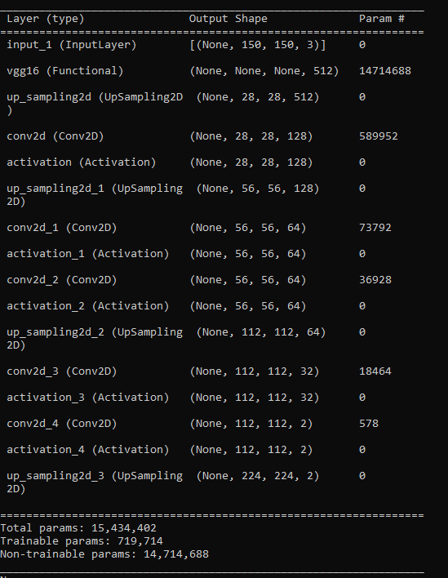
Autoencoder
Architecture

Slide 10
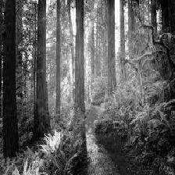
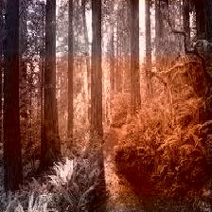
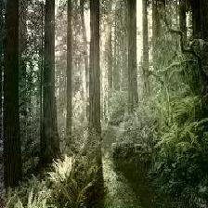
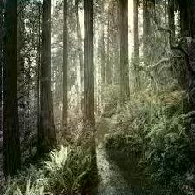
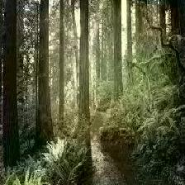
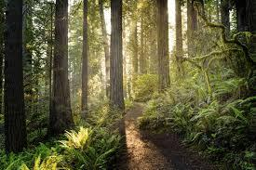
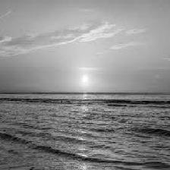
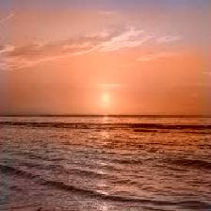
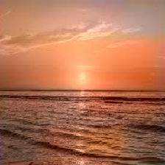
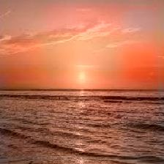
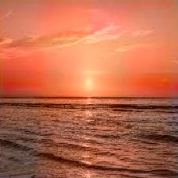
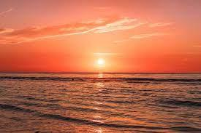
Results
Input
Epoch 10
Epoch 25
Epoch 50
Epoch 75
Ground Truth

Slide 11
Performance Metrics
SSIM
Structural Similarity Index Measure (SSIM), measures how similar two images are
Its range is from 0-1
Two identical images will have a SSIM of 1

Slide 12
Accuracy
SSIM | Epoch 10 | Epoch 25 | Epoch 50 | Epoch 75
Forest | 0.77 | 0.84 | 0.85 | 0.85
Sunset | 0.85 | 0.86 | 0.87 | 0.87

Slide 13
Q & A

Slide 14
Apendix

Slide 15
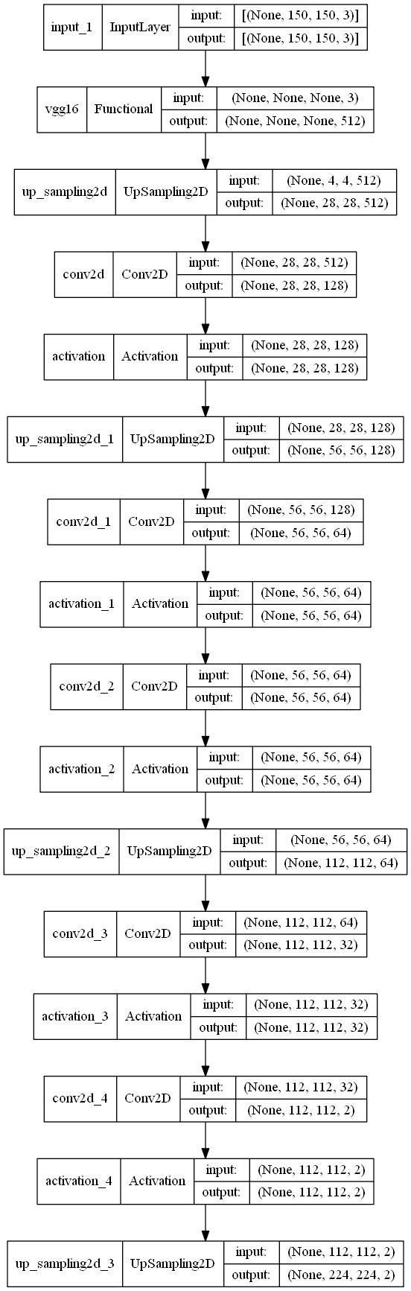
Architecture

Slide 16
Code Link
https://github.com/akshayjain777/CS584-Final-Project

